Slide 1

Library Management System
The Library Management System provides a comprehensive platform for managing a library's operations, including the admin portal, librarian portal, and member portal. This system streamlines key functions such as book borrowing, reservations, and reporting to enhance the overall library experience.
Team Members
Sai Bhavanesh Darsi
Varun Sai Buduru
SaiCharanTej Katteboina
Shreya Amardeep Siodiya
Lakshmi Gayatriaishwarya Adduri

Slide 2
Tech Stack
Backend: Java, Spring Boot
Frontend: HTML, CSS
Database: CSV files

Slide 3
Problem Statement
Our Library Management System (LMS) project aims to simplify the management of library resources, borrowing requests, and user interactions. Challenges include creating efficient user management tools for admins, librarians, and members, ensuring smooth authentication and authorization processes, and managing book borrowing requests effectively. Additionally, we aim to provide a streamlined system for private space booking within the library. Technological challenges involve ensuring scalability and data integrity with our CSV database and integrating various technologies like Java, Spring Boot, HTML, and CSS seamlessly. We're focusing on implementing design patterns and object-oriented principles for maintainability, along with robust exception handling and proper file operations. Finally, organizing our project structure and providing clear deployment instructions are crucial for a user-friendly experience. Addressing these challenges will result in a robust LMS that enhances library operations and user experiences in the digital era.

Slide 4
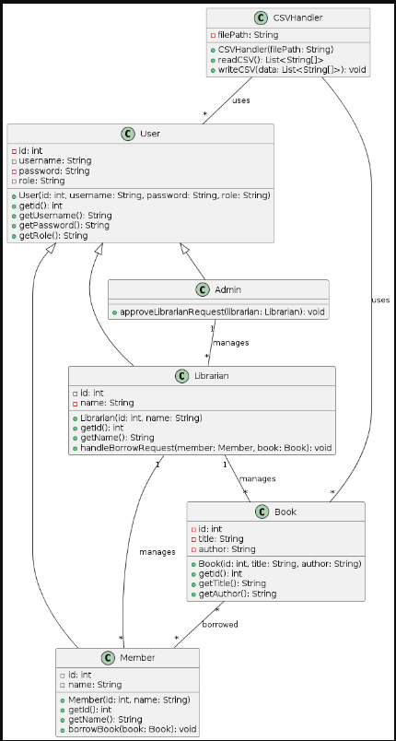
UML

Slide 5

Librarian Portal
1
Book Checkout
Librarians can efficiently check out books to members and manage returns.
2
Reservation System
Librarians can handle member requests for reserving books or private study rooms.
3
Inventory Updates
Librarians can update the system with new book arrivals and departures.

Slide 6




Monitoring and Reporting
Usage Analytics
Circulation Reports
Inventory Management
Patron Engagement
Track book checkouts, room reservations, and other usage metrics.
Monitor book loan periods, returns, and trends in member activity.
Manage book acquisitions, cataloging, and overall collection health.
Analyze member feedback and satisfaction to enhance the user experience.

Slide 7
Admin Portal
User Management
Inventory Control
Reporting & Analytics
The admin can manage user accounts, including librarians and members, and set permissions.
Admins can track book inventory, handle acquisitions, and monitor circulation trends.
Comprehensive reports and analytics provide insights to optimize library operations.

Slide 8
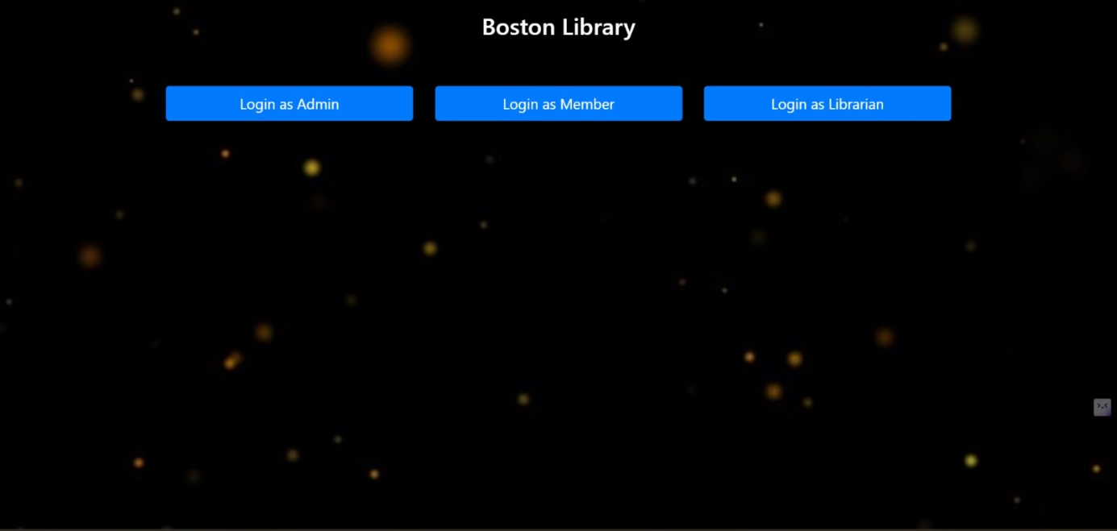

Slide 9
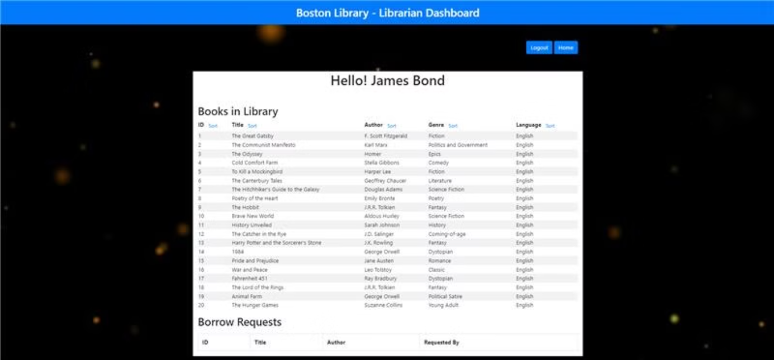

Slide 10
Librarian Functions
Book Recommendations
Research Assistance
Librarians can provide personalized book recommendations based on member preferences.
Librarians can help members conduct in-depth research and find relevant resources.
Patron Education
Interlibrary Loans
Librarians can teach members how to effectively use the library's digital resources.
Librarians can facilitate the borrowing of books from other libraries.

Slide 11
Member Portal
Book Search
Account Management
Room Reservations
Members can easily search the library's catalog to find and reserve books.
Members can manage their account, including borrowing history and fines.
Members can reserve private study rooms for individual or group work.

Slide 12
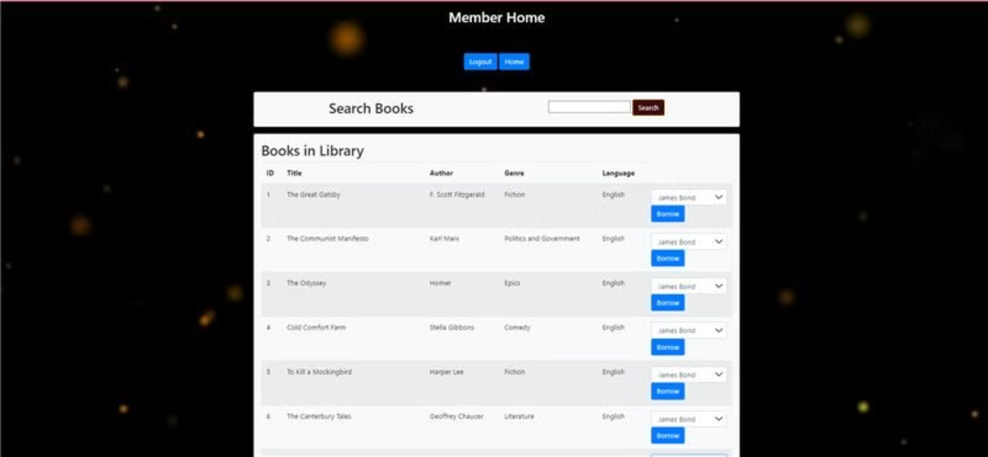

Slide 13
Member Functions
1
Book Borrowing
2
Returns and Renewals
Members can borrow books for a specified loan period and renew them as needed.
Members can return books on time or request renewals to avoid late fees.
3
Notifications
4
Feedback and Suggestions
Members receive timely notifications about due dates, overdue books, and reserved items.
Members can provide feedback and suggestions to improve the library's services.

Slide 14
Design Patterns
1
MVC (Model-View-Controller):
2
Factory:
Used for creating different types of users (admin, librarian, member).
The application is designed using the MVC architecture to separate concerns and facilitate better maintainability.
3
Lambdas and Comparators
4
Singleton
Lambda expressions and the Stream API are used for concise filtering and processing of data. In methods like `searchLibrarians()` and `searchApplications()`, they efficiently extract data based on specified conditions, enhancing search functionality.
Singleton pattern is used where only one instance of a class is created

Slide 15
Contributions
BACKEND CODE
Front end code: HTML, CSS
Controllers: Lakshmi GayatriAishwarya Adduri
Pojo: Shreya Amardeep Sisodiya
Service: SaiCharanTej Katteboina
HTML: Varun Sai Buduru
CSS: Sai Bhavanesh Darisi

Slide 16

Conclusion
The Library Management System provides a robust and user-friendly platform to streamline the operations of a modern library. By integrating the admin, librarian, and member portals, the system ensures efficient book management, enhanced patron experience, and insightful reporting for continuous improvement.

